Slide 1

Intro to object-oriented programming
Chapter 9 - polymorphism

Slide 2
polymorphism
This chapter is about the second major tenet of OOP: polymorphism. Its component parts are from the Greek: the prefix poly means “much” or “many,” and morphism means “shape,” “form,” or “structure.”
So, polymorphism essentially means many forms. Rather than one thing taking on many shapes, polymorphism in OOP is about how multiple classes can have methods with the exact same names. This will eventually give us a highly intuitive way to act on a collection of objects, independent of what class each came from.
OOP programmers often use the term “send a message” when we talk about client code calling a method of an object. What the object should do when it receives the message is up to the object. With polymorphism, we can send the same message to multiple objects, and each object will react differently depending on what it’s designed to do and the data available to it.
In this chapter, I’ll discuss how this ability allows you to build packages of classes that are easily extensible and predictable. We’ll also use polymorphism with operators to make the same operators perform different operations depending on the data types they are working with. Finally, I’ll show you how to use the print() function to get valuable debugging information from objects.

Slide 3
Sending Messages to Real-World Objects
Let’s look at polymorphism in the real world, using cars as an example. All cars have an accelerator pedal. When the driver presses that pedal, they’re sending the “accelerate” message to the car. The car they’re driving could have an internal combustion engine or an electric motor, or be a hybrid. Each of these types of cars has its own implementation of what happens when it receives the accelerate message, and each behaves accordingly.
Polymorphism allows for easier adoption of new technology. If someone were to develop a nuclear-powered car, the user interface of the car would remain the same—the driver would still press the accelerator pedal to send the same message—but a very different mechanism would make the nuclear-powered car go faster.
As another real-world example, imagine you enter a large room with a bank of light switches that control a variety of different lights. Some of the bulbs are old-style incandescent bulbs, some are fluorescent, and some are newer LED bulbs. When you flip all the switches up, you are sending the “turn on” message to all the bulbs. The underlying mechanisms that cause incandescent, fluorescent, and LED bulbs to emit light are wildly different, but each achieves the user’s intended goal.

Slide 4
A Classic Example of Polymorphism in Programming
In terms of OOP, polymorphism is about how client code can call a method with the exact same name in different objects, and each object will do whatever it needs to do to implement the meaning of that method for that object.
The classic example of polymorphism is to consider code that represents different types of pets. Let’s say you have a collection of dogs, cats, and birds, and each understands some basic commands. If you ask these pets to speak (that is, you send the “speak” message to each), the dogs will say “bark,” the cats will say “meow,” and the birds will say “tweet.”
EXAMPLE: Sending the “speak” message to objects instantiated from different classes

Slide 5
Example Using Pygame Shapes
Next, we’ll look at a demonstration of polymorphism using pygame. In Chapter 5 we used pygame to draw primitive shapes such as rectangles, circles, polygons, ellipses, and lines. Here we’ll build a demonstration program that will randomly create and draw different shapes in a window. The user can then click on any shape, and the program will report the type and area of the shape that was clicked. Because the shapes are randomly created, each time the program runs, the size, location, number, and position of the shapes will be different.
We’ll implement the program with a class for each of three different shapes: Square, Circle, and Triangle. The key thing to note here is that all three shape classes contain methods with the same names, __init__(), draw(), getType(), getArea(), and clickedInside(), that perform the same tasks. However, the implementation of each method is different because each class deals with a different shape
EXAMPLE: The Square class

Slide 6
The Circle and Triangle Shape Classes
Next, let’s take a look at the code of the Circle and the Triangle classes. The important thing to notice is that these classes have methods with the same names as the Square class, but the code in these methods (especially clickedInside() and getArea()) is very different.
EXAMPLE: The Circle and Triangle classes

Slide 7
THE CIRCLE AND TRIANGLE SHAPE CLASSES
To understand the polymorphism at work here, let’s look at the codeof the clickedInside() method for each shape. The clickedInside() method of the Square class was very simple: a check to see if the mouse click occurred inside the rectangle of the Square. The details of the calculations for clickedInside() in the Circle and Triangle classes are not particularly important, but they clearly are doing different calculations.
The clickedInside() method of the Circle class only reports a click if the user clicks on a colored pixel of the shape. That is, it detects a click that is within the bounding rectangle of the circle, but the click must also be within the radius of the circle for it to count as a click. The clickedInside() method of the Triangle class must determine if the user has clicked on a pixel inside the colored triangular portion of the rectangle. The methods in all three classes accept a mouse click as a parameter and return either True or False as a result.
The getArea() and draw() methods of these classes have names that are identical to methods of the Square class, but they do different work internally. There’s a different calculation for area, and they draw different shapes.

Slide 8
The Main Program Creating Shapes
EXAMPLE: The main program that creates random shapes from three classes
As we saw in Chapter 4, whenever we have a large number of objects to manage, the typical approach is to build a list of objects. So, before the main loop starts, the program first builds a list of shapes by randomly choosing among a circle, a square, and a triangle; creating an object of that type; and appending it to the list. Using this approach, we can then iterate over the list and call methods of the same name in every object in the list.
Inside the main loop, the program checks for the mouse down event that happens when the user clicks. Whenever the event is detected, the code iterates through the shapesList and calls the clickedInside() method for each shape. Because of polymorphism, it doesn’t matter which class the object was instantiated from. Again, the key is that the implementation of the clickedInside() method can be different for different classes.
When any clickedInside() method returns True, we call the getArea() then getType() methods of that object, without worrying about which type of object was clicked on.

Slide 9
Extending a Pattern
Building classes with commonly named methods creates a consistent pattern that allows us to easily extend the program. For example, to add the ability for our program to include ellipses, we would build an Ellipse class that implements the getArea(), clickedInside(), draw(), and getType() methods. (The code of the clickedInside() method might be mathematically complicated for an ellipse!)
Once we’ve written the code of the Ellipse class, the only change we need to make to the setup code is to add Ellipse to the tuple of shape classes to choose from. The code in the main loop that does the checking for clicks, gets the area of the shape, and so on will not need to change at all.
This example demonstrates two important features of polymorphism:
Polymorphism extends the concept of abstraction discussed in Chapter 8 to a collection of classes. If multiple classes have the same interfaces for their methods, the client programmer can ignore the implementation of those methods in all the classes.
Polymorphism can make client programming easier. If a client programmer is already familiar with the interfaces provided by one or more classes, then calling the methods of another polymorphic class should as be simple as following the pattern.

Slide 10
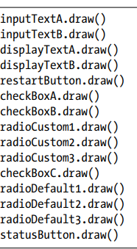
pygwidgets Exhibits Polymorphism
All the classes in pygwidgets were designed to use polymorphism, and they all implement two common methods. The first is the handleEvent() method we first used in Chapter 6, which takes an event object as a parameter. Each class must contain its own code in this method to handle any event that pygame may generate. Each time through the main loop, client programs need to call the handleEvent() method for every instance of every object instantiated from pygwidgets.
Second is the draw() method, which draws images to the window. A typical drawing portion of a program that uses pygwidgets might look like this:

Slide 11
PYGWIDGETS EXHIBITS POLYMORPHISM
From the client’s point of view, each line just calls the draw() method and passes in nothing. From an internal point of view, the code to implement each of these methods is very different. The draw() method of the TextButton class is completely different from that of the InputText class, for instance.
Additionally, all widgets that manage a value contain a setValue() and optionally a getValue() method. For example, to get the text the user enters into an InputText widget, you call the getValue() getter method. Radio button and checkbox widgets also have a getValue() method to get their current values. To put new text into a DisplayText widget, you call the setValue() setter method, passing in the new text. Radio button and checkbox widgets can be set with a call to their setValue() method.
Polymorphism allows client programmers to feel comfortable with a collection of classes. When clients see a pattern, like using methods named handleEvent() and draw(), it makes it easy for them to predict how to use a new class in the same collection.
The pygwidgets package does not provide either a horizontal or a vertical Slider class widget to allow a user to easily select from a range of numbers. If I were to add these widgets, they would certainly contain the following: a handleEvent() method, where all user interaction would take place; a getValue() and a setValue() method to get and set a current value for the Slider; and a draw() method.

Slide 12
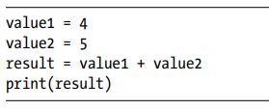

Polymorphism for Operators
Python also exhibits polymorphism with operators. Consider the following example with the + operator:
which prints:

Slide 13
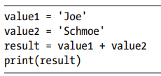

POLYMORPHISM FOR OPERATORS
The + operator here clearly means “add” in a mathematic sense because both variables contain integer values. But now consider this second example:
which prints:

Slide 14
POLYMORPHISM FOR OPERATORS
The line result = value1 + value2 is exactly the same as in the first example, but it performs a completely different operation. With string values, the + operator performs a string concatenation. The same operator was used, but a different action was performed.
This technique of having multiple meanings for an operator is commonly known as operator overloading. For some classes, the ability to overload operators adds highly useful features and greatly improves the readability of client code.

Slide 15

Magic Methods
Python reserves method names with the unusual form of two underscores, some name, and two underscores for a particular purpose:
These are officially called special methods but are more commonly referred to by Python programmers as magic methods. Many of these are already defined, such as __init__(), which is called whenever you instantiate an object from a class, but all other names in this style are available for future expansion. These are known as “magic” methods because Python calls them behind the scenes whenever it detects an operator, a special function call, or some other special circumstance. They are not intended to be called by client code directly.

Slide 16

MAGIC METHODS
Continuing with the previous examples, we’ll look at how this works with the + operator. The built-in data types (integer, float, string, Boolean, and so on) are actually implemented as classes in Python. We can see this by testing with the built-in isinstance() function, which takes an object and a class and returns True if the object was instantiated from the class or False if not. These lines will both report True:
The classes for the built-in data types contain a set of magic methods, including ones for the basic math operators. When Python detects the + operator with integers, it calls the magic method named __add__() in the built-in integer class, which performs integer addition. When Python sees the same operator used with strings, it calls the __add__() method in the string class, which performs string concatenation.
This mechanism is generalized so that when Python encounters a + operator when working with objects instantiated from your class, it will call the __add__() method if one is present in your class. Therefore, as the class developer, you can write code to invent a new meaning for this operator.
Each operator maps to a specific magic method name. While there are many types of magic methods, let’s start with those related to the comparison operators.

Slide 17


Comparison Operator Magic Methods
Consider our Square class. You want client software to be able to compare two Square objects to see if they are equal. It is up to you to decide what “equal” means when comparing objects. For instance, you might define it as two objects being the same color and at the same location and with the same size. As a simple example, we’ll define two Square objects as equal if they just have the same side length. This is easily implemented by comparing the self.heightAndWidth instance variables of the two objects and returning a Boolean. You could write your own equals() method, and client software could then call it like this:
This would work fine. However, it would be more natural for client software to use the standard == comparison operator:
Written this way, Python translates the == operator into a call to a magic method of the first object. In this case, Python will attempt to call a magic method named __eq__() in the Square class.

Slide 18
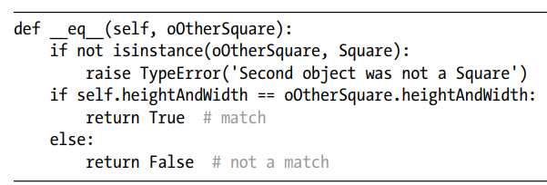
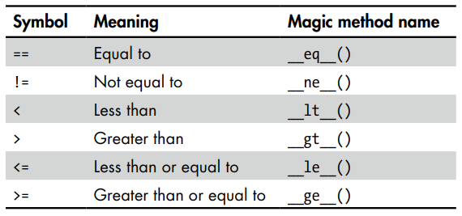
COMPARISON OPERATOR MAGIC METHODS
To allow the == comparison operator to check for equality between two Square objects, you would write a method like this in the Square class:
When Python detects an == comparison where the first object is a Square, it calls this method in the Square class. Since Python is a loosely typed language (it doesn’t require you to define variable types), the second parameter could be of any data type. However, in order for the comparison to work correctly, the second parameter must also be a Square object. We perform a check using the isinstance() function, which works with programmerdefined classes the same way it works with built-in classes. If the second object is not a Square, we raise an exception.
We then compare the heightAndWidth of the current object (self) with the heightAndWidth of a second object (oOtherSquare). This is a case where using direct access to the instance variables of two objects is perfectly acceptable, because both objects are of the same type, and therefore they must contain the same instance variables.

Slide 19
A Rectangle Class with Magic Methods
To expand, we’ll build a program that draws a number of rectangle shapes using a Rectangle class. The user will be able to click on any two rectangles, and the program will report if the rectangles have the same area or if the area of the first one is larger or smaller than the area of the second rectangle. We’ll use the ==, <, and > operators and expect the result to be a Boolean True or False for each comparison
EXAMPLE: The Rectangle class

Slide 20


A RECTANGLE CLASS WITH MAGIC METHODS
The methods __eq__(), __lt__(), and __gt__() allow client code to use standard comparison operators between Rectangle objects. To compare two rectangles for equality, you would write:
When this line runs, the __eq__() method of the first object is called, and the second object is passed in as the second parameter. The function returns either True or False. Similarly, to compare for less than, you would write a line like this:
The __lt__() method then checks for the area of the first rectangle being less than the area of the second rectangle. If client code used the > operator to compare two rectangles, the __gt__() method would be called.

Slide 21
Main Program Using Magic Methods
EXAMPLE: The main program that draws and then compares Rectangle objects
The user of the program clicks on pairs of rectangles to compare their sizes. We store the selected rectangles in two variables. We check for equality using the == operator, which resolves to calling the __eq__() method of the Rectangle class. If the rectangles are the same size, we print out an appropriate message. If not, we check if the first rectangle is smaller than the second using the < operator, which results in a call to the __lt__() method. If this comparison is also not True, we print the message for the first being larger than the second. We didn’t need to use the > operator in this program; however, since other client code might implement size comparisons differently, we’ve included the __gt__() method for completeness.
Finally, we draw all the rectangles in our list. Because we included the magic methods __eq__(), __lt__(), and __gt__() in the Rectangle class, we were able to use the standard comparison operators in a highly intuitive and readable way.

Slide 22
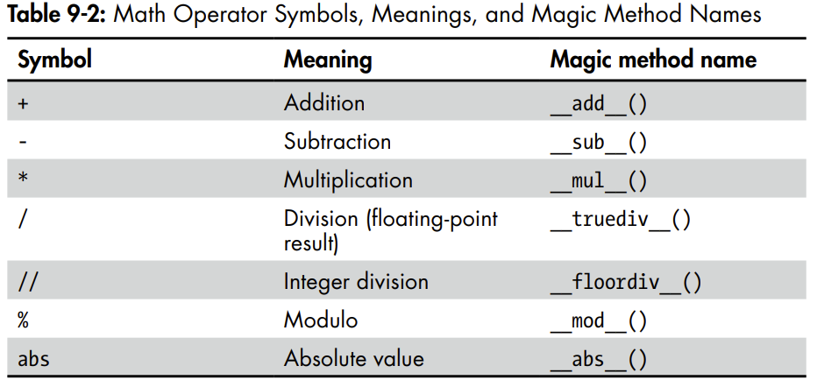
Math Operator Magic Methods
You can write additional magic methods to define what happens when client code uses the other arithmetic operators between objects instantiated from your class.

Slide 23
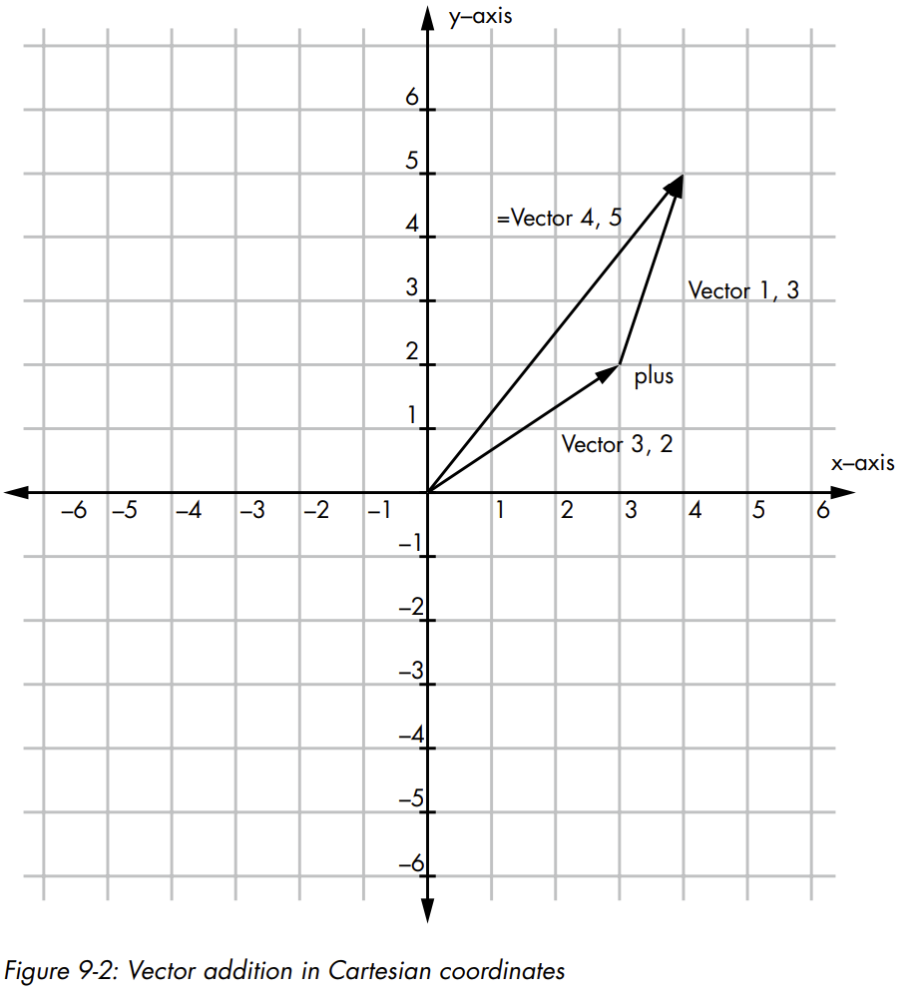
Vector Example
In math, a vector is an ordered pair of x and y values that is often represented on a graph as a directed line segment. In this section, we’ll build a class that uses math operator magic methods to operate on vectors.
There are a number of math operations that can be performed on vectors. Figure 9-2 shows an example of adding two vectors.
Adding two vectors results in a new vector whose x value is the sum of the x values of the two added vectors and whose y value is the sum of the y values of the two added vectors. In Figure 9-2, we add the vector (3, 2) and the vector (1, 3) to create a vector (4, 5).

Slide 24
Vector example
Two vectors are considered equal if their x values are the same and their y values are the same. A vector’s size is computed to be the hypotenuse of the right triangle with one side of length x and the second side of length y. We can use the Pythagorean theorem to compute the length and use the lengths to compare two vectors’ sizes.
EXAMPLE is a Vector class that illustrates the appropriate magic methods for doing math and comparisons between two Vector objects.
EXAMPLE: Vector addition in Cartesian coordinates

Slide 25

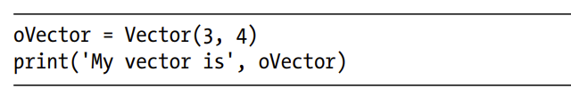

Creating a String Representation of Values in an Object
A standard approach to debugging is to add calls to print() to write out the values of variables at certain points in your program:
However, if you try to use print() to help you debug the contents of an object, the results are not particularly helpful. For example, here we create a Vector object and print it:
This is what is printed:
This tells us that we have an object instantiated from the Vector class and shows the memory address of that object. However, in most cases, what we really want to know are the values of the instance variables in the object at that moment. Luckily, we can use magic methods for that

Slide 26
CREATING A STRING REPRESENTATION OF VALUES IN AN OBJECT
There are two magic methods that can be useful in getting information (as strings) from an object:
The __str__() method is used to create a string representation of an object that can be read easily by humans. If client code makes a call to the str() built-in function and passes in an object, Python will call the magic method __str__() if it is present in that class.
The __repr__() method is used to create an unambiguous, possibly machine-readable string representation of the object. If client code makes a call to the repr() built-in function and passes in an object, Python will attempt to call the magic method __repr__() in that class, if present.
I’ll show the __str__() method, as it’s more generally used for simple debugging. When you call the print() function, Python calls the built-in str() function to convert each argument into a string. For any argument that does not have a __str__() method, this function formats a string that contains the type of the object, the words “object at,” and the memory address, then returns the resulting string. That’s why we see the earlier output containing the memory address.
Instead, you can write your own version of __str__() and have it produce whatever string you want to help debug the code of your class. The general approach is to build a string that contains the values of any instance variables that you want to see and return that string to be printed.

Slide 27
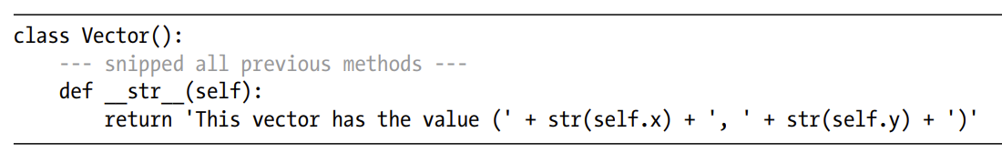
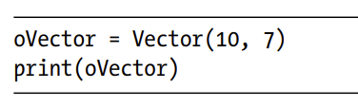

CREATING A STRING REPRESENTATION OF VALUES IN AN OBJECT
For example, we can add the following method to the Vector class from previous EXAMPLE to get information about any Vector object:
If you instantiate a Vector, you can then call the print() function and pass in a Vector object:
Rather than just printing the memory address of the Vector object, you will get a nicely formatted report of the values of the two instance variables contained in the object:

Slide 28
summary
This chapter was about the key OOP concept of polymorphism. Stated simply, polymorphism is the ability for multiple classes to implement methods with the same names. Each class contains specific code to do whatever needs to be done for objects instantiated from that class. As a demonstration program, I showed how you could create a number of different shape classes, each of which had an __init__(), getArea(), clickedInside(), and draw() method. The code of each version of these methods was specific to the type of the shape.
As you saw, there are two key advantages to using polymorphism. First, it extends the concept of abstraction to a collection of classes, allowing the client programmer to ignore the implementation. Second, it allows for a system of classes that work in similar ways, making a system predictable to client programmers.
I also discussed the idea of polymorphism in operators, explaining how the same operator could do different operations with different types of data. I showed how Python’s magic methods are used to make this happen and how you can build methods to implement these operators in your own classes. To demonstrate the use of arithmetic and comparison operator magic methods, I showed a Vector class. I also showed how you can use the __str__() method to help in debugging the content of an object.

